Slide 1
An overview of the Open Force Field project, project aims and achievements
Oct. 13, 2021 | David Mobley / AstraZeneca

Slide 2
Particular thanks to
Simon Boothroyd
Jeff Wagner

Slide 3

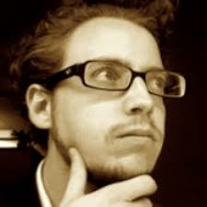
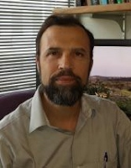

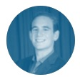
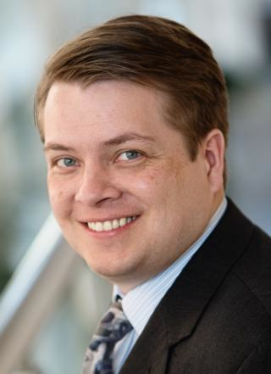

The Open Force Field Consortium
INDUSTRY
ACADEMIC
AbbVie
BASF
Bayer
Boehringer-Ingelheim
Bristol Myers Squibb
Cresset
Janssen
GlaxoSmithKline
Merck KGaA
OpenEye
Pfizer
Roche
Vertex
Eli Lilly
… and others
John Chodera (MSKCC)
Michael Gilson (UC San Diego)
David Mobley (UC Irvine)
Michael Shirts (CU Boulder)
PROJECT STAFF
Jeff Wagner
Technical Lead
Simon Boothroyd
Science Lead
Plus affiliates:
Danny Cole (Newcastle)
Lee-Ping Wang (UCD)
Dennis Della Corte (BYU)
MolSSI (Virginia Tech)
...

Slide 4




How is the Open Force Field Initiative open?
Open source Python Toolkit: use the parameters in most simulation packages
Open curated QM / physical property datasets: build your own force fields
Open infrastructure: Run your own benchmarks; fit your own FFs
Open science: Everything done in the open/everyone can get involved
Notes:
Nothing proprietary/secret; everyone benefits. Democratization of FFs!

Slide 5
What is the Open Force Field Initiative producing?
Toolkits: Modern toolkits for rapid development, application, and evaluation of force fields
Parameters: Parameterized datasets for different model resolutions
Datasets: Curated collections of physical property measurements
Community: Bringing together top developers & users and working together to solve our problems in the open so everyone benefits
Best Practices: Measurement and calculation of physical properties
Standards: Representation of molecular systems; forcefield descriptions
Documentation: Theory; toolkit documentation; tutorials and training materials
Publications: Communicating the ideas behind our work to the scientific community

Slide 6
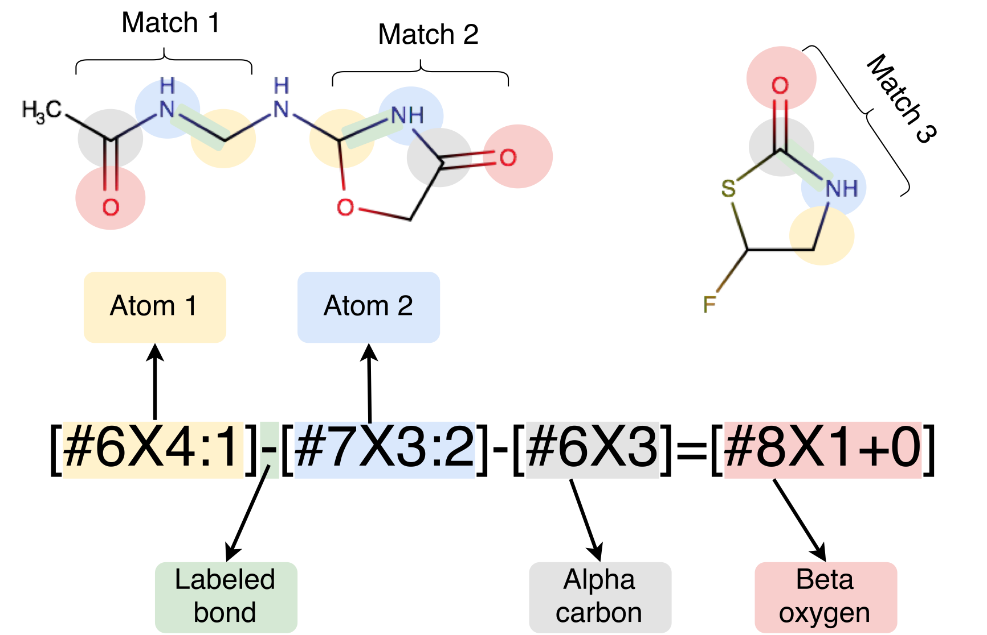
The SMIRKS Native Open Force Field spec. (SMIRNOFF) avoids atom typing, simplifies parameter assignment
match bonds directly:
Use of industry-standard SMARTS/SMIRKS chemical perception greatly simplifies tooling for parameter assignment while solving issues with extensibility and flexibility

Slide 7
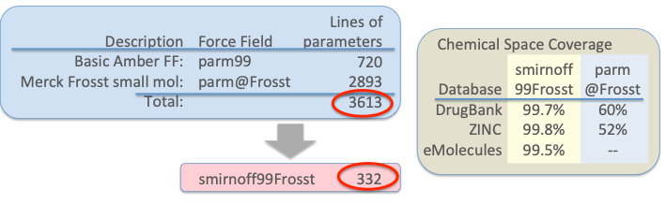
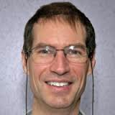
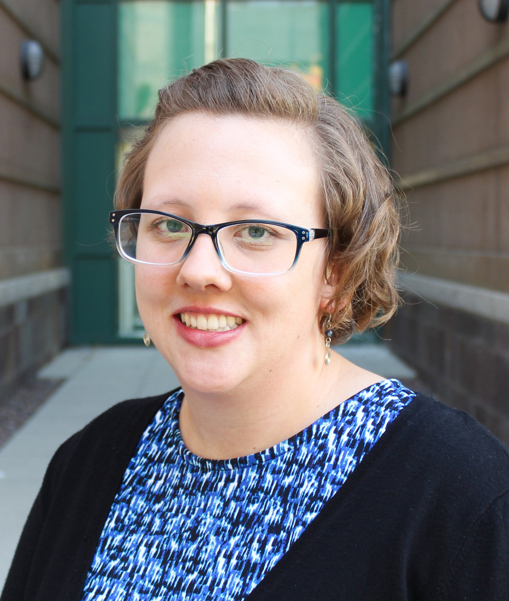
SMIRNOFF allowed significant compression of smirnoff99Frosst, our AMBER-lineage starting point
Less than 1/10 the size of the original force field
Removes redundancy
Almost completely covers pharmaceutical chemical space

Slide 8
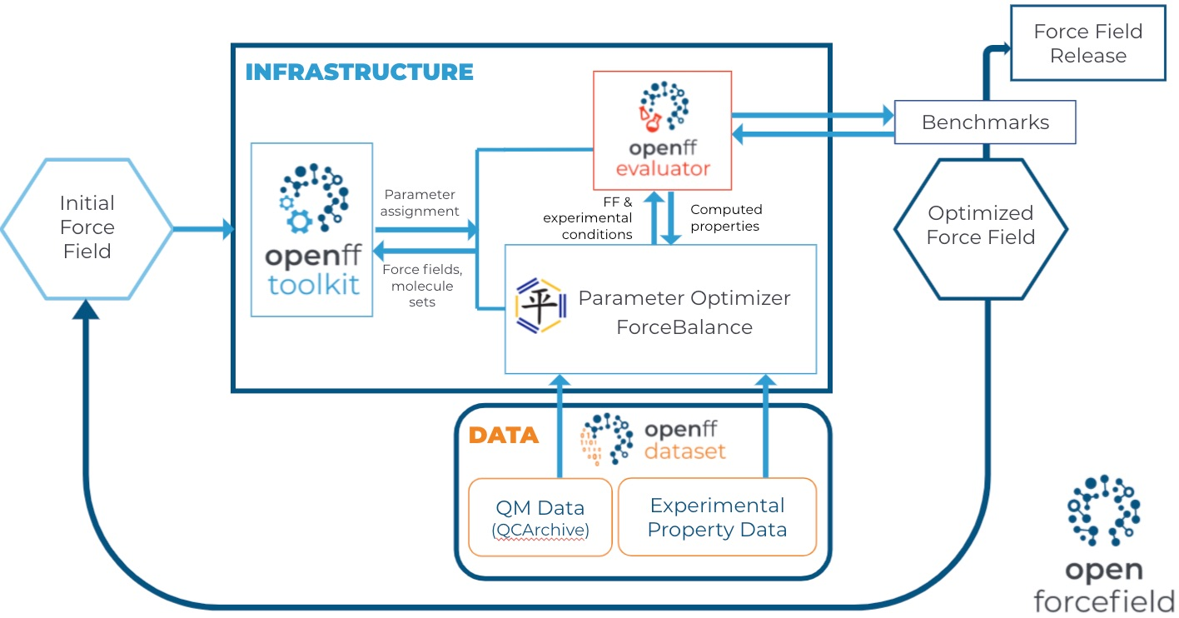
We’ve come a long way since our late 2018 start
Notes:
Started in Oct. 2018. A key part of our first year, we’ll call it 2019, was building out this infrastructure. Culminated in about three or four FF fits in a couple of months to release OpenFF 1.0
Image source here: https://docs.google.com/presentation/d/1d5hbFAmz0jgLCavhNTgjfqwWTvKELFLvrQ52B6u0XzI/edit#slide=id.p6

Slide 9

Since Parsley (OpenFF 1.0) we’ve had a string of releases
A series of fixes and improvements leading up to Sage (2.0)
1.0.0 (10/2019): The first optimized force field
1.1.0 03/2020): More valence parameter refits and some fixes
1.2.0 (06/2020): Expanded and redesigned QM dataset dramatically improved accuracy
1.2.1 (09/2020): Bugfix for propynes/HMR
1.3.0 (10/2020): Addresses some amide issues
1.3.1 (06/2021): Bugfix for sulfonamide geometries
In parallel, tons of new science -- tens to hundreds of fitting experiments to test out a wide range of ideas, e.g. effect of vibrational frequency fitting
Notes:
1.2 towards end of year 2
1.3 at end of year 2
SAY WHEN 1.3.1 is rolling out

Slide 10
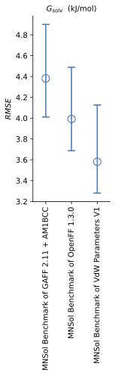
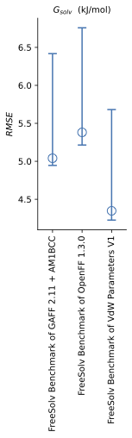
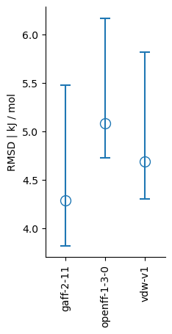
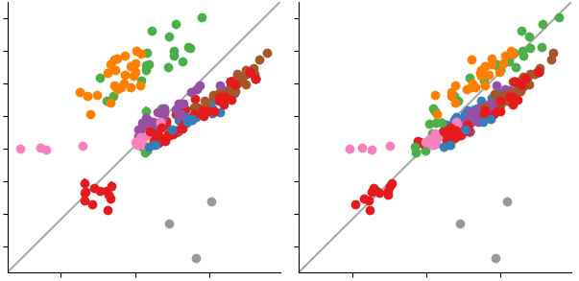

Our Sage release does better on mixture and condensed phase properties
PREVIOUS STUDY SHOWS FITTING TO H_{MIX} RESOLVES SYSTEMATIC ERRORS
Non- aq. ΔG_{solv}
aq. ΔG_{solv}
Non-aq. -> aq. ΔG_{trans}
openff-1.0.0
H_{mix}(𝑥) + 𝜌(𝑥)
Experimental H_{mix}
RMSE kJ / mol
Estimated H_{mix}
Estimated H_{mix}
alcohol + ester
alcohol + ketone
Notes:
Emphasise that it’s this approach that should IN THE FUTURE enable use to train small molecule, amino acid, sugar etc interactions self consistently. Clearly wins to be had by capturing mixture interactions especially for different concentrations

Slide 11
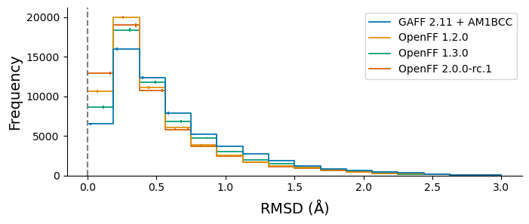
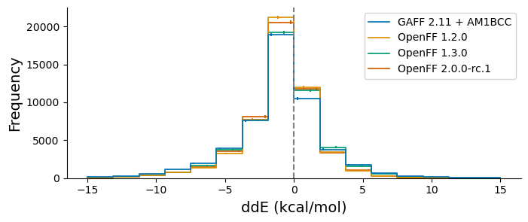
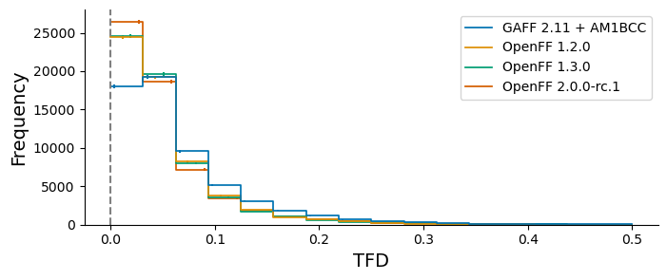
Automated benchmarking with industry has been great, indicates progress relative to QM
SAGE showed excellent performance when benchmarked against the Public OpenFF Industry Benchmark Season 1 v1.0
* 95% bootstrapped confidence intervals

Slide 12






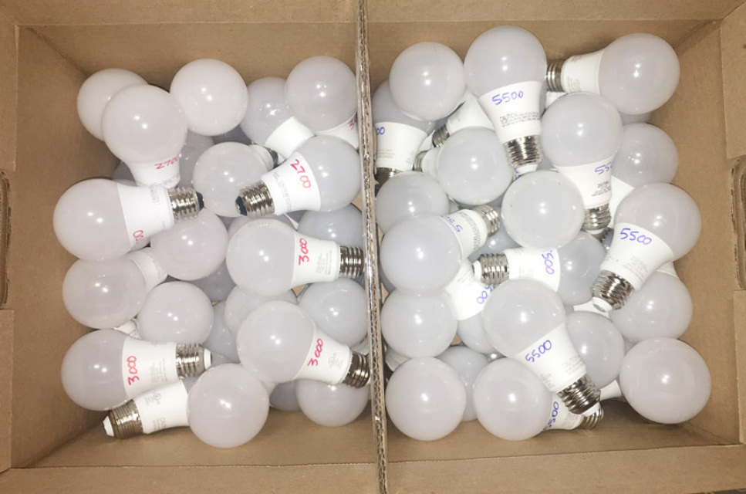
The process works, and it’s changing how we think about building force fields
We viewed this originally as a linear, planned process
FF
ForceBalance
Test
We’re learning it works better as a parallel process where the best ideas may be unexpected and apparent only later
...
Notes:
Examples of serial: WBO interpolation had been promised for Sage release, but it’s not quite ready yet, so we’re deferring
Examples of parallel: Bespoke fit, modified Seminario approaches weren’t part of mainstream plans for FF but they’re solving some of our problems so we’re pulling in key ideas, infrastructure or using them to improve FFs
Mention broader collaborations: Cole group, Roitberg group, Della Corte, Cresset, Relay …

Slide 13

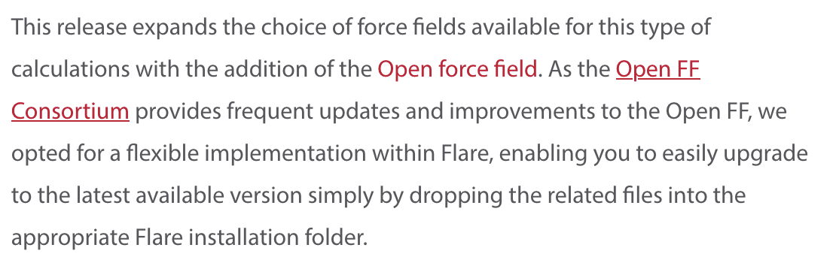
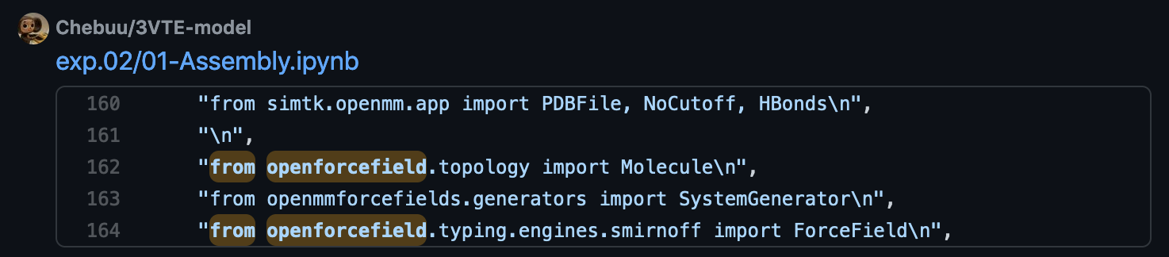
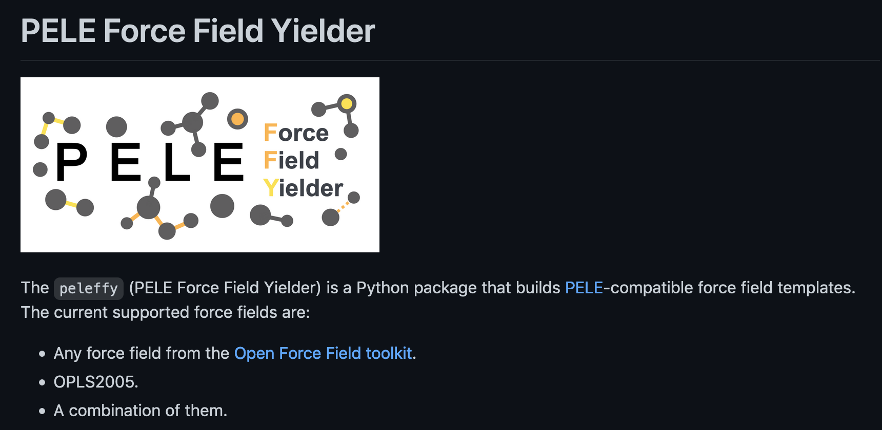
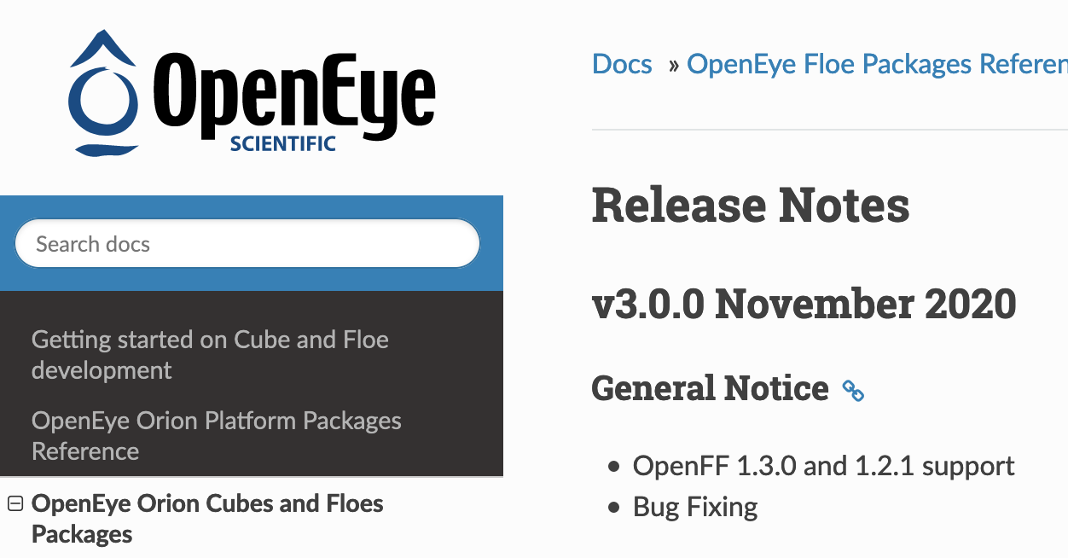

Infrastructure
Making it easy to USE force fields
Use of OpenFF tools outside the Initiative
Companies including Cresset and OpenEye
Collaborators including MoSDeF, Rowley, and Cole labs
Unaffiliated groups around the world
Strangers on GitHub!
Notes:
On the previous slide, I mentioned that we’re designing our software to become part of other workflows
This is hard thing to measure -- for the first two years, we were throwing software releases and force fields into a void
We’ve engaged in a few direct collaborations, for example with the MoSDeF efforts, and these are going well, but what we’d really like to reach is spontaneous adoption
And what’s exciting is that now we’re starting to see results sprouting
Go through bullets
So I think this reflects well on our efforts to make our results easy for people to use

Slide 14
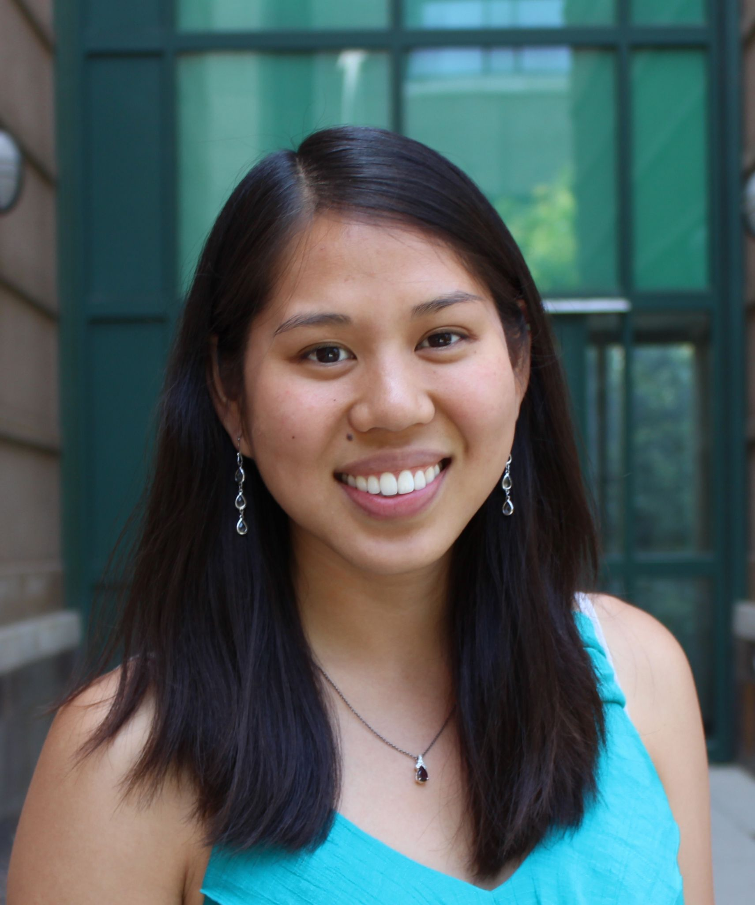
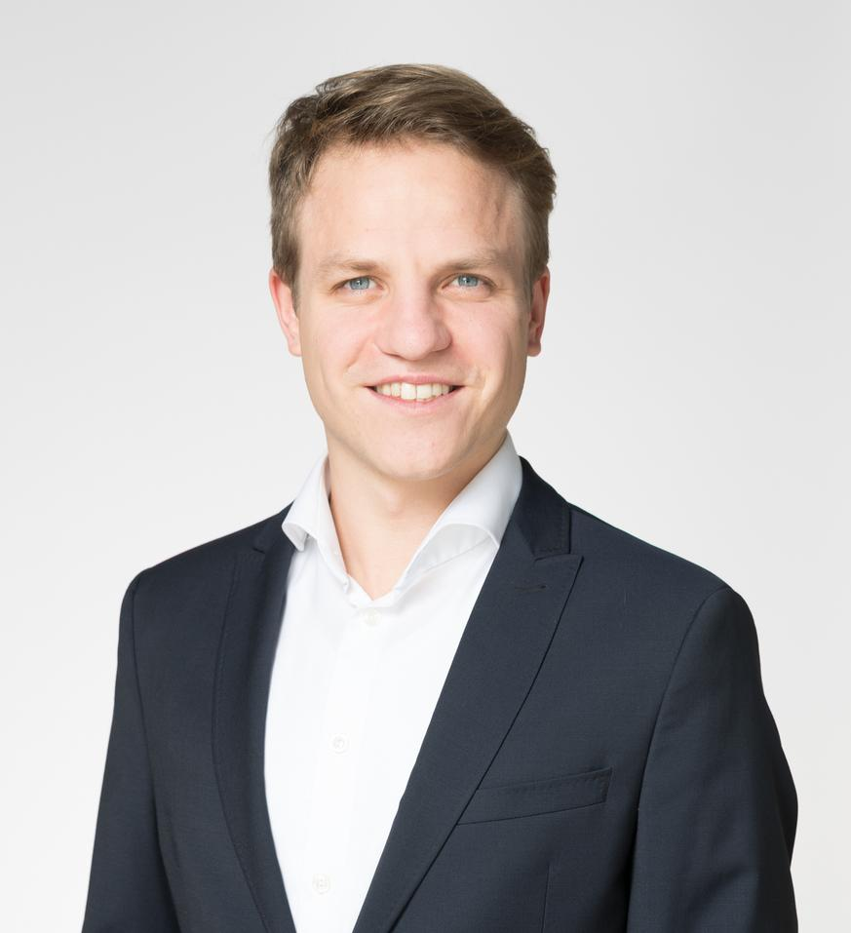

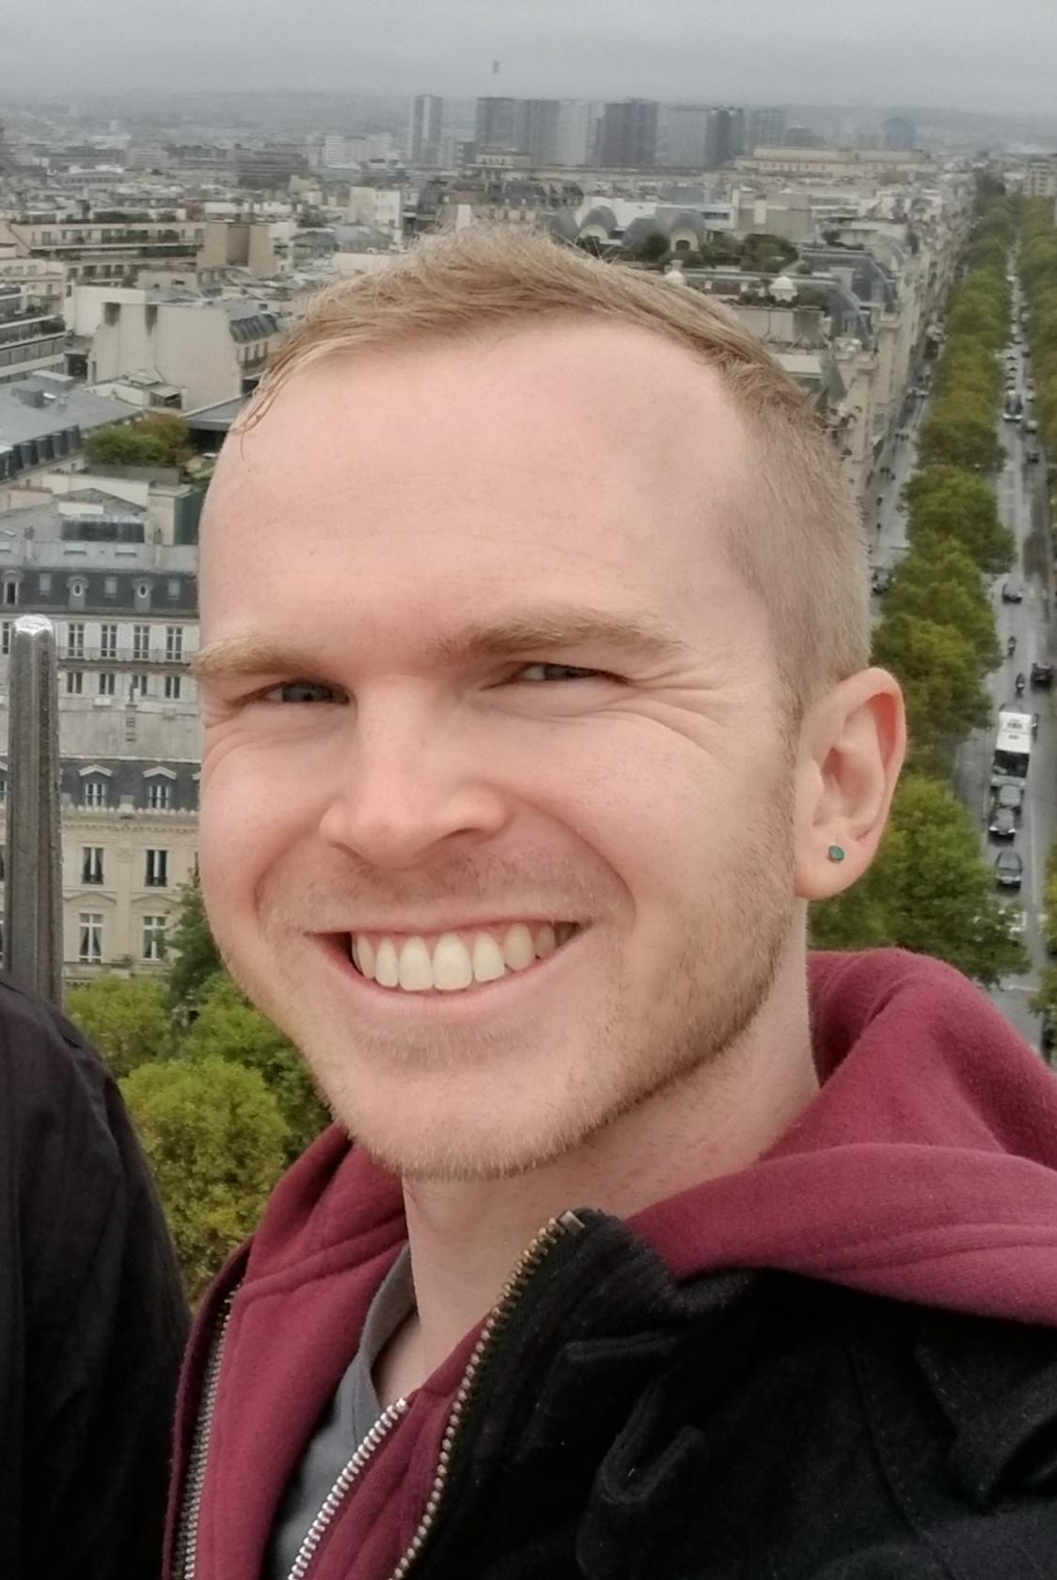
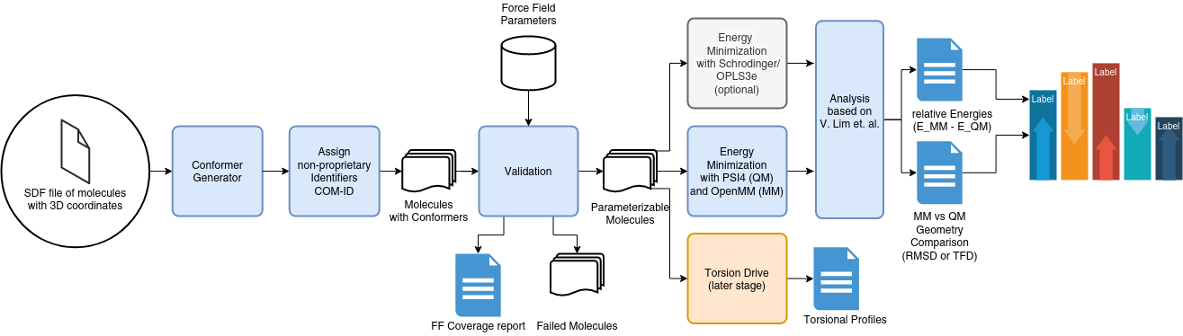
Infrastructure
Making it easy to COMPARE force fields
OpenFF Benchmark
Automates running the Lim and Hahn benchmark
CLI-first approach, using OpenFF Python backend
Heavily pinned environments and conda installers to provide consistent results
Lim VT, Hahn DF, Tresadern G et al. Benchmark assessment of molecular geometries and energies from small molecule force fields [version 1; peer review: 2 approved]. F1000Research 2020, 9(Chem Inf Sci):1390 (https://doi.org/10.12688/f1000research.27141.1)
Notes:
The Open force field team had been talking about how to get people to try our stuff
Basically, it’s a chicken and egg problem, where people have finite time, and they’d need to SPEND some of that time using our stuff in order to be CONVINCED that it works, but they won’t spend the energy to try it UNLESS they already think it’ll work
Earlier this year, we began an effort to automate the Victoria Lim and David Hahn force field comparison study.
Our goal with this was to let people test OUR force fields on a dataset of THEIR choosing, in as automated a fashion as possible.
David Dotson made this figure to explain how it works:Explain figure
Each company participating in the study submitted some non-proprietary 3D compounds to us, and we’re running the workflow on those.
They’re also running a separate dataset of their choosing internally, and we’re collecting the summary statistics of those to produce a big pooled study.
So, hopefully, this has people seeing the performance of our force fields and tools on molecules that they really care about.
What was surprising was how smoothly the distribution of this software went.
We packaged the openFF toolkit, openMM, the psi4 quantum chemistry software, QCEngine, and QCSubmit with a small CLI frontend, and people were actually able to feed in molecules and have thousands of QC jobs executed locally.
It was super cool, and I think it worked because of our great team and the way we’ve been developing open force field software internally to be intercompatible.

Slide 15



OPEN Software, OPEN Data, OPEN Science is rapidly facilitating force field science!
OPEN SOFTWARE
OPEN DATA
OPEN SCIENCE
Automated infrastructure enables rapid experimentation with minimum human intervention
Access to large, high quality experimental and quantum chemical data facilities easy curation of balanced train / test sets
Exploring new force field science:
hypothesis - build software - train - test - iterate
is now almost routine

Slide 16
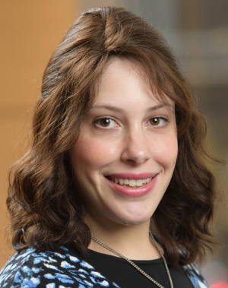
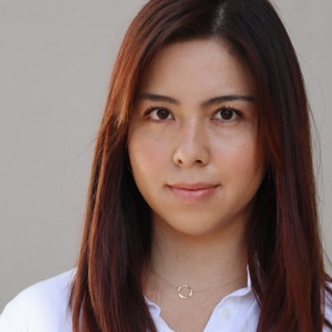

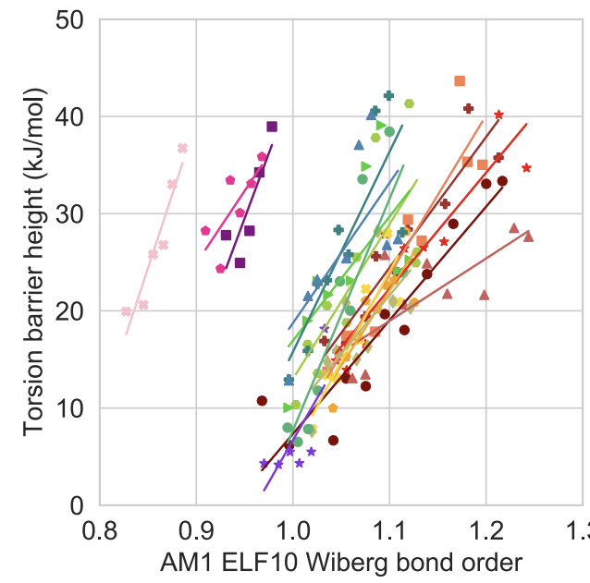


WBO Interpolation - promising force field science not quite ready for the prime time
Chaya Stern
Jessica Maat
Pavan Behara
forcebalance
Hypothesis
Software
Training
Testing
Data Driven Decision
Wiberg Bond Order and torsion barrier height strong correlated
Add support for interpolating torsion barrier height using WBO to OpenFF toolkit
New WBO interpolated torsion parameters added and FF refits performed
Performance of the refit parameters assessed against QC data
FF performance after including new parameters - inclusion in Sage deferred

Slide 17
OpenFF Sage - the next INCREMENTAL generation of OpenFF force field
OpenFF Sage commences the next generation of OpenFF force fields
2016
2019
2021
202X
SMIRNOFF99Frosst
Parsley
Sage
Rosemary
Initial SMIRNOFF port of the parm99Frosst force field
Retrained valence parameters against a redesigned QC data set
Retrained vdW parameters against physical property data + retrained valence parameters
Self consistent biopolymer + small molecule force field
Notes:
ultimately this process - have an idea, integrate into soft, train, test, and analyse is at the heart of incrementally improving the OpenFF force fields.
For pasley Retrain valence against redesigned QC set , etc.
Sage the next step in process
Ultimately, everything being done is leading up to the point of having a self consistent biopolymer and small molecule FF

Slide 18
OpenFF Sage - select vdW parameters trained against experimental MIXTURE enthalpies and densities
PREVIOUS STUDY SHOWS FITTING TO H_{MIX} RESOLVES SYSTEMATIC ERRORS
Mixture properties offer large benefits over pure properties alone
Easily incorporate interactions between solvent, ligands, amino acids, sugars etc
Training set includes ~1000 mixture enthalpy and density data points (NIST ThermoML)
Directly includes aqueous (TIP3P) mixtures
Small organic molecules (C, H, N, O, Cl, Br), ambient conditions, 3 concentrations
Made possible by the OpenFF Evaluator
openff-1.0.0
H_{mix}(𝑥) + 𝜌(𝑥)
Experimental H_{mix}
Estimated H_{mix}
Estimated H_{mix}
alcohol + ester
alcohol + ketone
Notes:
Sage not only first release that includes a select set of refit vdW parameters, but vdW parameters refit to mixture properties based on data driven OpenFF science.
Emphasise that it’s this approach that should IN THE FUTURE enable use to train small molecule, amino acid, sugar etc interactions self consistently. Clearly wins to be had by capturing mixture interactions especially for different concentrations

Slide 19
OpenFF Sage - positive improvements observed for solvation / transfer free energies
Benchmarked refit vdW parameters against solvation free energies + transfer free energies
Subset of FreeSolv and MNSol
Some caution required given fixed charged force field
While outlook looks positive, biggest gains likely once electrostatics consistently refit
Non- aq. ΔG_{solv}
aq. ΔG_{solv}
Non-aq. -> aq. ΔG_{trans}
RMSE kJ / mol
Notes:
Need to stress here again that although the first pass at vdW refits are likely showing a step in the right direction, this is a STEPPING STONE for bigger things. This fitting approach is critical for our future efforts for self consistent bio-polymer and small molecule interaction parameters.

Slide 20
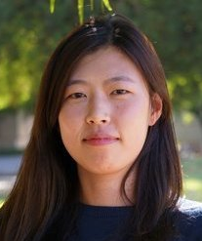
OpenFF Sage - exploring which data best informs valence parameters
Explored constructing torsion drive sets by combinatorially combining small, chemically diverse fragments (Gen 3)
reduce steric hindrance / electrostatic interactions while retaining a diversity of chemistry around central bond
ultimately not yet included due to poor test set performance - still WIP
Revisited which data should valence terms be trained against
Train against vibrational frequency or not?
Use modified Seminario method to derive force constants?
Include all available data or filter to ensure balanced training set?
Filter optimized geometry to retain only distinct conformers
Hyesu Jang

Slide 21
OpenFF Sage - without introducing new QC data we’ve again improved opt-geo RMSD and ddE
SAGE 2.0.0 showed excellent performance when benchmarked against the Public OpenFF Industry Benchmark Season 1 v1.0
* 95% bootstrapped confidence intervals
Notes:
Showing that even without introducing new data, re-evaluating choice of fitting approach can still yield incremental improvements. The power of the automated benchmarking infrastructure, combined with diverse molecules of pharma interest, allows us to more rapidly perform test fits as evaluating ‘has this improved’ becomes more routine and standardised.

Slide 22
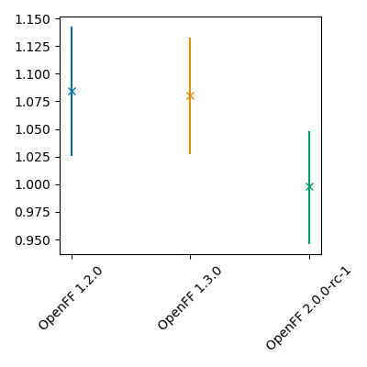
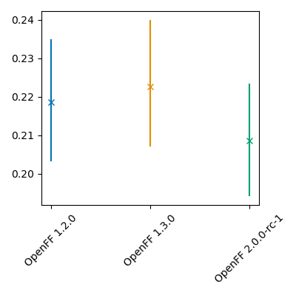
OpenFF Sage - benchmarked torsion profiles appear to exhibit good performance
SAGE 2.0.0 likewise predicts well the torsion profiles of a fragmented set of JACS ligands (OpenFF-benchmark-ligand-fragments-v1.0)
<RMSD> kcal / mol
<Scaled RMSD> kcal / mol
* 95% bootstrapped confidence intervals
Notes:
Beginning to explore how best to also benchmark other elements of the force field. Computing the average RMSD between a set QC and MM torsion profiles gives information about the overall agreement in magnitudes of the two profiles as well as some feature information, will computing the RMSD between to profiles scaled by their maximum barrier height we’ve found yields a reasonable indicator of the ‘shape’ of two profiles. In both cases the new RC release of SAGE appears to perform well.
Want to expand to other metics - how well does individual moiety geometry match, for e.g. so we can get a finer view of where deficiencies in FF may lay.

Slide 23
The protein-ligand benchmark set consists out of
22 targets, 599 ligands and 1150 alchemical perturbations
Content/preparation of Benchmark set might change in the future.
What is the purpose for changing (better quality, new chemistries, …)?
How do we ensure that we always compare calculations with the same input structures?
Sources
Schrodinger JACS L. Wang et al. , J. Am. Chem. Soc., 2015, 137 , 2695 —2703.
Merck KgGA Christina E. M. Schindler et al., Large-Scale Assessment of Binding Free Energy Calculations in Active Drug Discovery Projects, J. Chem. Inf. Model. 2020, 60, 11, 5457–5474
Janssen/Other: V. Gapsys et al., Large scale relative protein ligand binding affinities using non-equilibrium alchemy, Chem. Sci., 2020,11, 1140-1152 Laura Perez Benito et al., Predicting Activity Cliffs with Free-Energy Perturbation, J. Chem. Theory Comput. 2019, 15, 3, 1884–1895
Best practices: Hahn DF et al., Best practices for constructing, preparing and evaluating protein-ligand binding affinity benchmarks.arXiv:210506222 [physics,q-bio].2021 May;
Target | # Ligands | #Perturbations | Target | # Ligands | #Perturbations
jnk1 | 21 | 31 | bace_p2 | 12 | 26
pde2 | 21 | 34 | tyk2 | 16 | 24
thrombin | 11 | 16 | ros1 | 28 | 63
p38 | 34 | 56 | eg5 | 28 | 65
ptp1b | 23 | 49 | cdk8 | 33 | 54
galectin | 8 | 7 | hif2a | 42 | 92
cdk2 | 16 | 25 | pfkfb3 | 40 | 66
cmet | 24 | 74 | pde10 | 35 | 36
mcl1 | 42 | 71 | shp2 | 26 | 56
bace | 36 | 58 | syk | 44 | 101
bace_hunt | 32 | 60 | tnks2 | 27 | 60
 |  |  | total | 599 | 1150
https://github.com/openforcefield/protein-ligand-benchmark

Slide 24
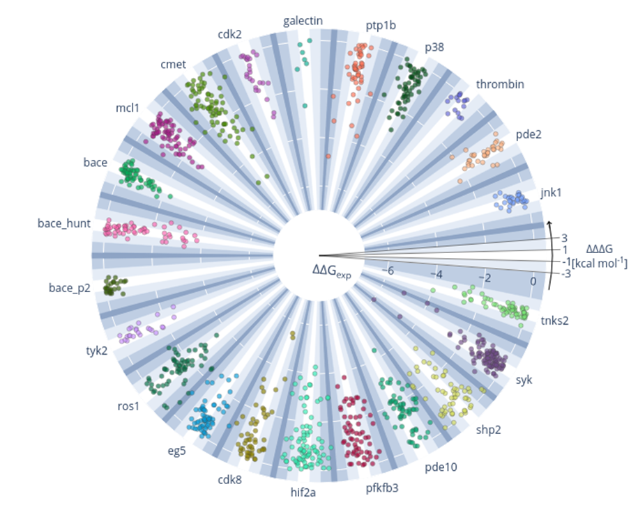
Results for all perturbations using pmx and Parsley (OpenFF 1.0.0)
Overview over all calculations performed
Radial: exp. ΔΔG in kcal/mol
Polar: difference between calc. and exp. ΔΔG, ΔΔΔG in kcal/mol

Slide 25
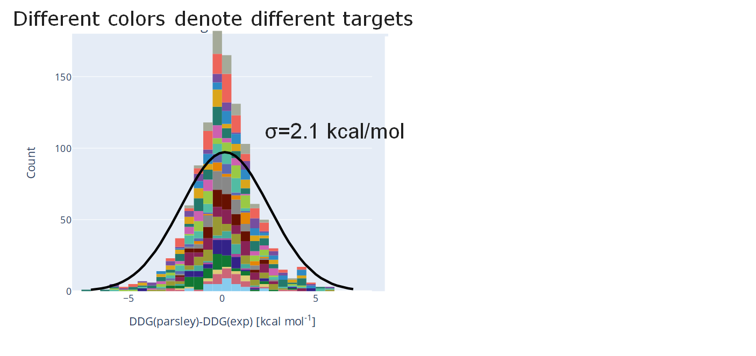
Most perturbations (∆∆G) deviate less than 1 kcal/mol from experiment
Abs. Error [kcal/mol] | # Perturbations | % of total
< 0.5 | 322 | 29
<1.0 | 592 | 52
<2.0 | 911 | 79
<3.0 | 1052 | 92
total | 1149 | 100
Origin of errors:
Set-up (poses, charges)
Sampling (simulation time)
Model accuracy (Force Field)
Experimental data

Slide 26
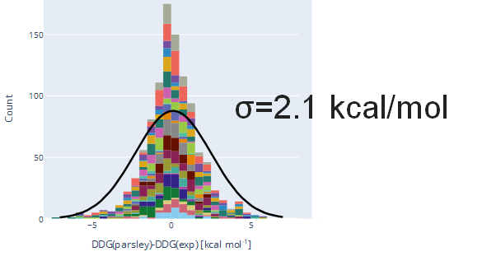
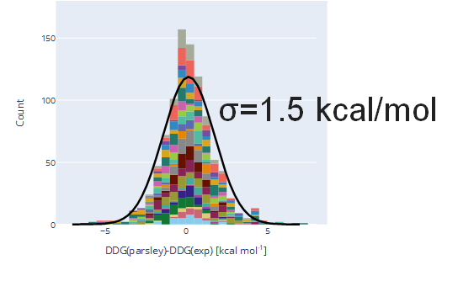
Results can be filtered based on different convergence metrics
All perturbations
Filtered perturbations
Abs. Error [kcal/mol] | # Perturbations | % of total
< 0.5 | 322 | 29
<1.0 | 592 | 52
<2.0 | 911 | 79
<3.0 | 1052 | 92
total | 1149 | 100
Abs. Error [kcal/mol] | # Perturbations | % of total
< 0.5 | 383 | 32
<1.0 | 508 | 57
<2.0 | 748 | 85
<3.0 | 835 | 94
total | 885 | 100

Slide 27
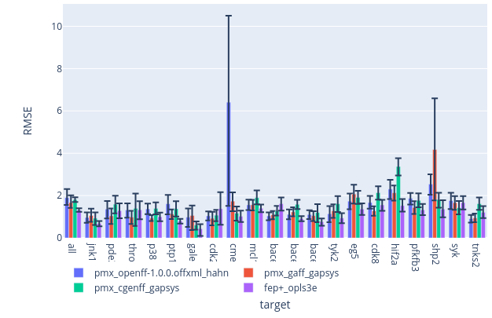
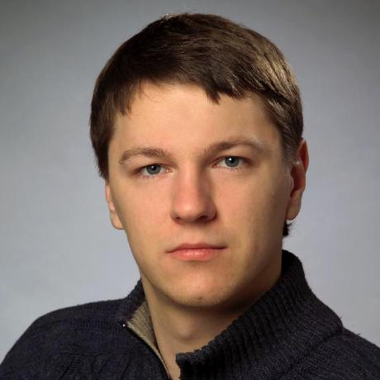
OpenFF-1.0 offers similar performance as other force fields
RMSE based on ΔΔG in kcal/mol
Error bars are 95% CI
OPLS3e is generally slightly, but non-significantly better
Vytas Gapsys
pmx/OpenFF-1.0
pmx/cGenFF
pmx/GAFF2
FEP+/OPLS3e

Slide 28
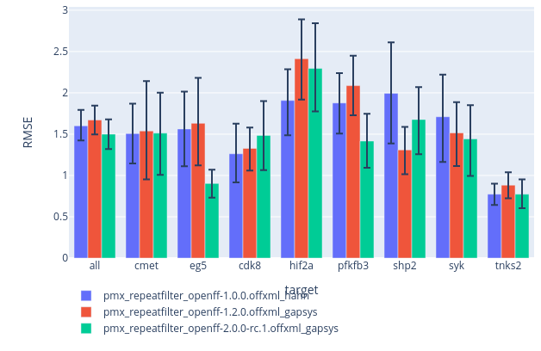
OpenFF-2.0-RC1 improved results over OpenFF-1.0
RMSE based on ΔΔG in kcal/mol
Error bars are 95% CI
OpenFF2.0RC1 is generally slightly, but non-significantly better
pmx/OpenFF-1.0
pmx/OpenFF-1.2
pmx/OpenFF-2.0RC1
Vytas Gapsys

Slide 29
OpenFF Sage - the next INCREMENTAL generation of OpenFF force field
Sage 2.0.0 available now on GitHub in the openff-sage repository
2016
2020
2021
202X
SMIRNOFF99Frosst
Parsley
Sage
Rosemary
Initial SMIRNOFF port of the parm99Frosst force field
Retrained valence parameters against a redesigned QC data set
Retrained vdW parameters against physical property data + retrained valence parameters
Self consistent biopolymer + small molecule force field
Notes:
Summarize progress - THE PROCESS WORKS - how this relates to rosemary and self consistent prot lig sug dna lipid etc force field - rc release available on github.

Slide 30
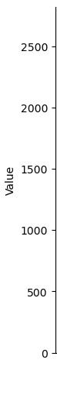
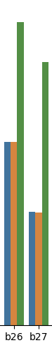
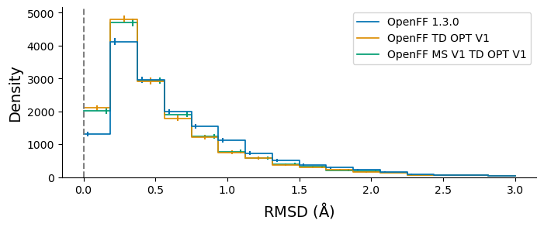
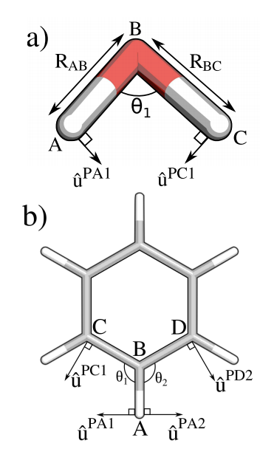

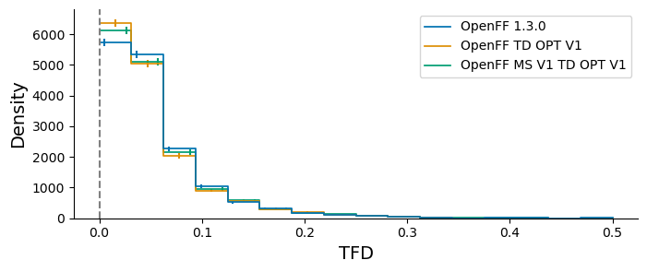
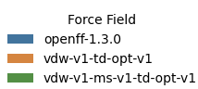
Modified Seminario* - heavily automated fitting pipeline used to explore new fitting target in days
b26=[#6:1]#[#7:2]
b27=[#6X2:1]#[#6X2:2]
b30=[#6X2:1]=[#7:2]
Josh Horton
Hypothesis
Force Constants Computed
Remaining Parameters Refit
New Parameters Benchmarked
Using the modified seminario method to derive bond and angle force constants directly from QC data yields more ‘physical’ values
The Cole group retrieved all hessian data generated by OpenFF and from this computed average bond and angle force constants
Within ~1 day OpenFF refit the rest of the valence parameters while restraining the force constants
Within a further ~1 day the new force field had been benchmarked against the QC data
* Alice E. A. Allen, Michael C. Payne, and Daniel J. Cole 10.1021/acs.jctc.7b00785

Slide 31
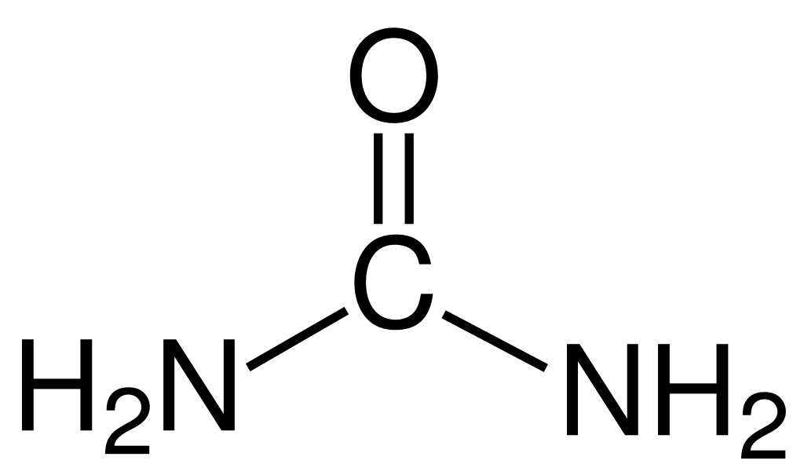

Refit Charge Models - AM1BCC charge model currently being re-trained against QC and exp. data
33
Double-bonded oxygen in a lactone or lactam
ESP / EF
+
+
O
O
RESP2 δ=0.6
O
N
[#8X1$(*=[#6r]@[#7r,#8r]):1]
Mixture enthalpies + densities
AM1BCC Ported to SMIRNOFF
Integrate Into Fitting Infrastructure
Training
Testing
A majority of the original AM1BCC parameters have been ported to SMIRNOFF
ForceBalance and the OpenFF Evaluator extended to support co-optimising against QC and exp. data
Test fits being performed against a combination of QC ESP / EF data and mixture exp. data
XtalPi benchmarking test fits against experimental solvation / transfer free energy data

Slide 32
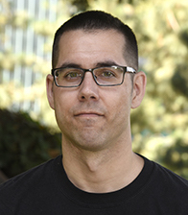
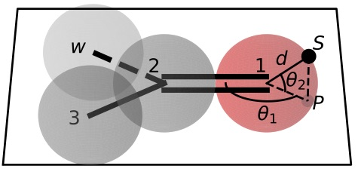
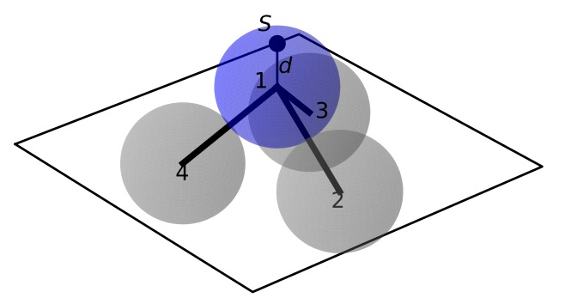
Virtual Sites - fitting infrastructure becoming available in weeks, followed by new science in months
+
ESP / EF
+
RESP2 δ=0.6
Trevor Gokey
Hypothesis
Software
Training
Testing
Interoperability
The inclusion of off-site charges should improve the accuracy of a force fields electrostatic interactions
Virtual site support added to the OpenFF toolkit. Support for training to QC ESP + EF data in progress
Virtual sites will be trained against ESP / EF QC data, based on input from the Cole group
Trained parameters will be benchmarked against experimental and physical property data
In order to include into mainline force field need major simulation packages to support proposed v-sites

Slide 33
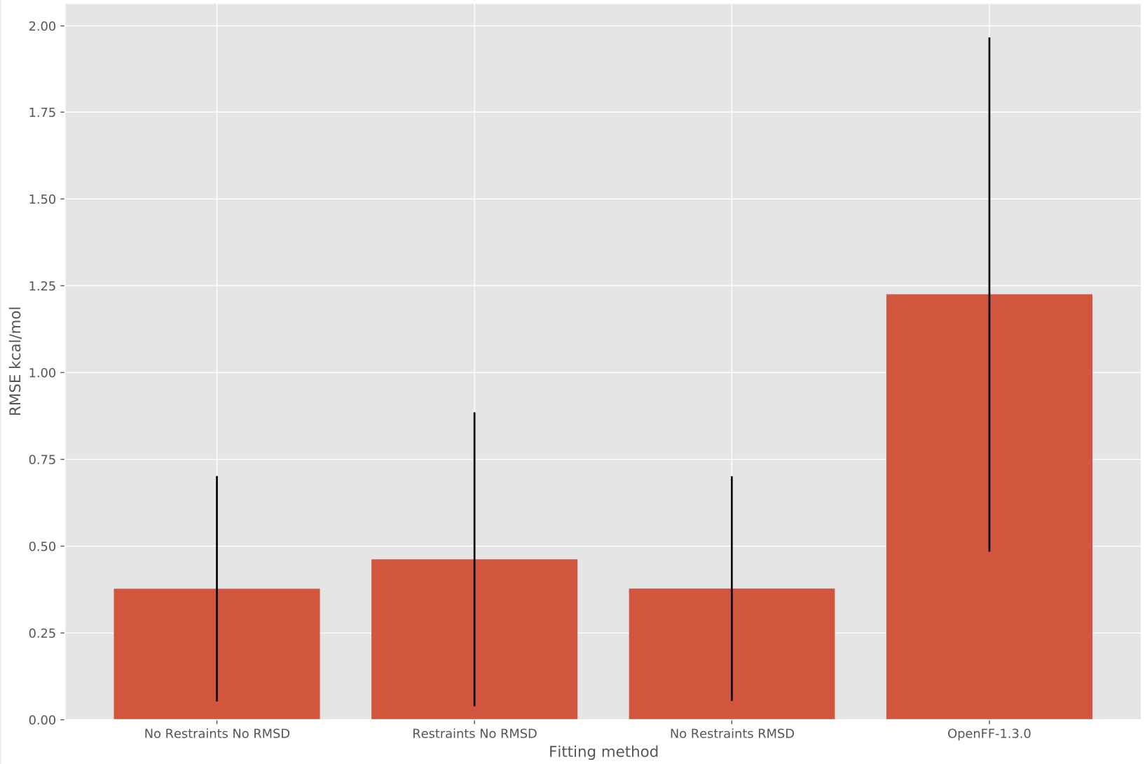
Bespoke Fitting - expect initial release of the bespoke fitting package in the next 1-2 months
TORSION PROFILE BEFORE AND AFTER FITTING THE JACS LIGAND FRAGMENTS
Can retrain torsion parameters to bespoke torsion scans generated for ‘fragments’ of original molecule
Working to expand to other valence terms
force constants from modified seminario method
Investigating the use of ANI2x models to rapidly generate torsion scan training data
2.00
1.50
Josh Horton
RMSE kcal / mol
1.00
0.50
0.00
OpenFF 1.3.0
Bespoke
* error bars show 1 std deviation

Slide 34
OPEN Software, OPEN Data, OPEN Science is rapidly facilitating force field science!
OPEN SOFTWARE
OPEN DATA
OPEN SCIENCE
Automated infrastructure enables rapid experimentation with minimum human intervention
Access to large, high quality experimental and quantum chemical data facilities easy curation of balanced train / test sets
Exploring new force field science:
hypothesis - build software - train - test - iterate
is now almost routine

Slide 35

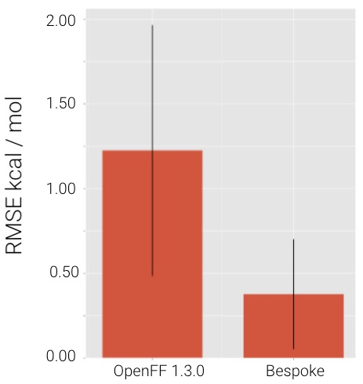
Conclusions
aq. ΔG_{solv}
Sage looks even better than we expected!
Automated benchmarking has been a major focus and will point the way forward
We see community uptake, with and without our help
Bespoke torsion fitting will be ready soon and yields accuracy gains
New technology yields better starting points and better FFs

Slide 36
Acknowledgements
https://openforcefield.org/about/organization/
Too many other folks over the years to list, including the AMBER FF community, the GAFF/GAFF2 developers, etc.
NIH and NSF for funding work that helped pave the way to this effort
Consortium and NIH for current funding, plus MolSSI and others for fellowship funding
OpenEye for support + Chris Bayly’s sabbatical which helped launch this

